Slide 1
Smart AC Remote with Voice Control
Submitted in the partial fulfillment for the award of the degree of
BACHELOR OF ENGINEERING
IN
Artificial Intelligence and Machine Learning
Submitted by:
Yash Dubey 21BCS9898
Sandhya 21BCS11860
Under the Supervision of:
Dr. Priyanka Kaushik
Department of AIT-CSE
DISCOVER . LEARN . EMPOWER

Slide 2
Outline
Introduction
Difference b/w previous AC remote and Smart AC remote
Problem Formulation
Objectives
Key Features
Methodology Used
System Architecture
Challenges
Results and Outputs
Future Scope
Conclusion

Slide 3
Introduction
Traditional AC remotes are limited to physical button controls.
Smart homes demand more intelligent and seamless control solutions.
This project aims to create a voice-controlled AC remote with an intuitive graphical interface, smart home integration, and energy efficiency tracking.

Slide 4
Difference
Feature | Traditional AC Remote | Smart Voice-Controlled AC Remote
Control Method | Manual button presses | Voice commands + Graphical User Interface (GUI)
Connectivity | Infrared (IR) only | Wi-Fi/IoT-ready
User Personalization | Not available | Supports user-specific profiles
Energy Monitoring | Not available | Real-time energy consumption tracking
Scheduling and Timers | Basic timer function | Smart scheduling and automation features
Push Notifications | Not available | Alerts for maintenance and high energy usage
Smart Home Integration | No integration with smart devices | Designed for Alexa, Google Home, IoT platforms

Slide 5
Problem Formulation
Limited Functionality – Traditional AC remotes rely solely on physical buttons, lacking advanced control options.
Inconvenient User Experience – Users must manually operate remotes, which can be inconvenient, especially for elderly or disabled individuals.
No Voice Control – Absence of voice command support restricts hands-free operation.
Energy Inefficiency – Traditional AC controls do not provide energy tracking or optimization features, leading to higher electricity consumption.

Slide 6
Objectives
To develop a voice-controlled AC remote with speech recognition.
To design a graphical interface (GUI) using Tkinter for ease of use.
To integrate IoT capabilities for seamless smart home automation.
To implement user-specific profiles for personalized AC settings.
To enable real-time energy monitoring to optimize power consumption.
To provide push notifications for maintenance and efficiency alerts.

Slide 7
Key Features
Graphical Interface (Tkinter-based) – Easy-to-use UI for manual control.
Voice Commands – Control AC settings via speech recognition.
Temperature Adjustment – Set desired cooling levels.
Fan Speed & Mode Selection – Adjust fan speed & switch between cooling, dry, and fan modes.
Timer & Scheduling – Automate AC operation for efficiency.
User Profiles – Personalized preferences for different users.
Smart Home Integration – Connect with IoT platforms like Alexa & Google Home.
Energy Usage Tracking – Monitor and optimize power consumption.
Push Notifications – Alerts for maintenance, high energy usage, etc.

Slide 8
Methodology used
System Design – Develop a smart AC remote with a graphical interface using Tkinter in Python.
Speech Recognition – Implement voice command processing for hands-free control.
Smart Home Integration – Enable connectivity with IoT platforms for seamless automation.
User Profiles & Customization – Allow personalized settings based on user preferences.
Energy Tracking & Optimization – Monitor usage and suggest energy-efficient operation.
Testing & Deployment – Conduct functional testing and integrate with smart home systems.

Slide 9
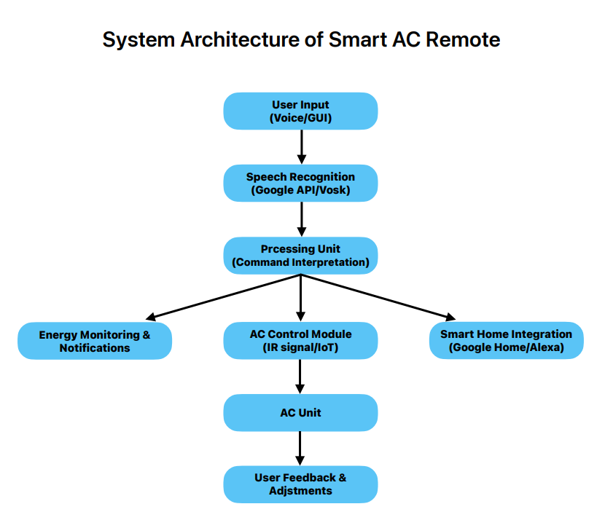
System Architecture

Slide 10
Challenges
Accurate speech recognition in noisy environments.
Ensuring compatibility with various AC models.
Optimizing response time for smooth user experience.
Smart home integration with different platforms.

Slide 11
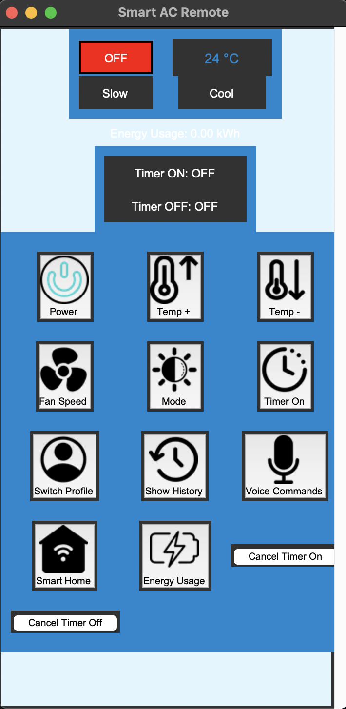
Result and Output

Slide 12
Future Scope
Adding gesture-based controls for hands-free operation.
Implementing machine learning for adaptive cooling based on user behavior.
Mobile App Integration for remote access.
Support for multiple languages in voice commands.

Slide 13
Conclusion
A smart AC remote has been developed to enhance user convenience and energy efficiency by enabling seamless voice control and smart home integration. This innovative solution allows users to operate their air conditioners effortlessly using voice commands while also optimizing energy consumption. Looking ahead, future improvements will focus on incorporating AI-driven automation for intelligent climate control and expanding accessibility through mobile applications, ensuring a more intuitive and connected user experience.

